Slide 1
Weekly report: Team Project Development
Week number: 13
Date: 22/12/2025
Supervisor: Dr. Marina Blohm
Group members: Luis Urhahn, Ahmed Sallam, Ceren Cetin, Sohail Mansuri

Slide 2
Progress of the week
The progress this week:
Updating the result file with the latest updates
Optimizing the power curve or turbine data
Defining the windfarm layout (3 or 4 WTGs)
Bird Migration
The Threatened and red list Migratory Birds
Luis Urhahn

Slide 3
Update of the Turbine Data
After the change of different parameters regarding the turbine, some data needed to be updated:
→ All the main parameters and site conditions are now fixed!
Main features | values | units | status
hub height | 100 | m | fixed
rotor diameter | 160 | m | fixed
rotor swept area | 20.106 | m^2 | fixed
blades length | 77.75 | m | fixed
Power output | 5.000.000 | W | fixed
Rated tip speed | 85,00 | m/s | fixed
rated rotational speed | 10,146 | rpm | fixed
rated wind speed | 10,37 | m/s | fixed
rated tip speed ratio | 8,19 |  | fixed
rated pitch angle | 5 | ° | fixed
Main features | values | units | status
optimal wind speed | 8,49 | m/s | fixed
optimal rotational speed | 8,61 | rpm | fixed
optimal tip speed ratio | 8,5 | - | fixed
cp _opt | 0,474 | - | fixed
cut in wind speed | 3 | m/s | fixed
cut out wind speed | 25 | m/s | fixed
cut in rotational speed | 3,04 | rpm | fixed
max rotational speed | 9,04 | rpm | fixed
Efficiency without Cp | 0,924 | - | fixed
Luis Urhahn

Slide 4
Progress: WindPro Simulation
Park Calculation with shadow curtailment:
Parameter | Unit | Value
Result Park (AEP) (no loss) | MWh/year | 22 491.8
Result Park (AEP) | MWh/year | 21 908.8
Capacity factor | % | 50
Full Load Hours (FLH) | Hours/year | 4 382
Average wind speed | m/s | 8.5
Curtailment loss | % | 2.6
Including the shadow restriction:
30 min before sunrise to 30 min after sunrise → shutdown of turbine
Luis Urhahn

Slide 5
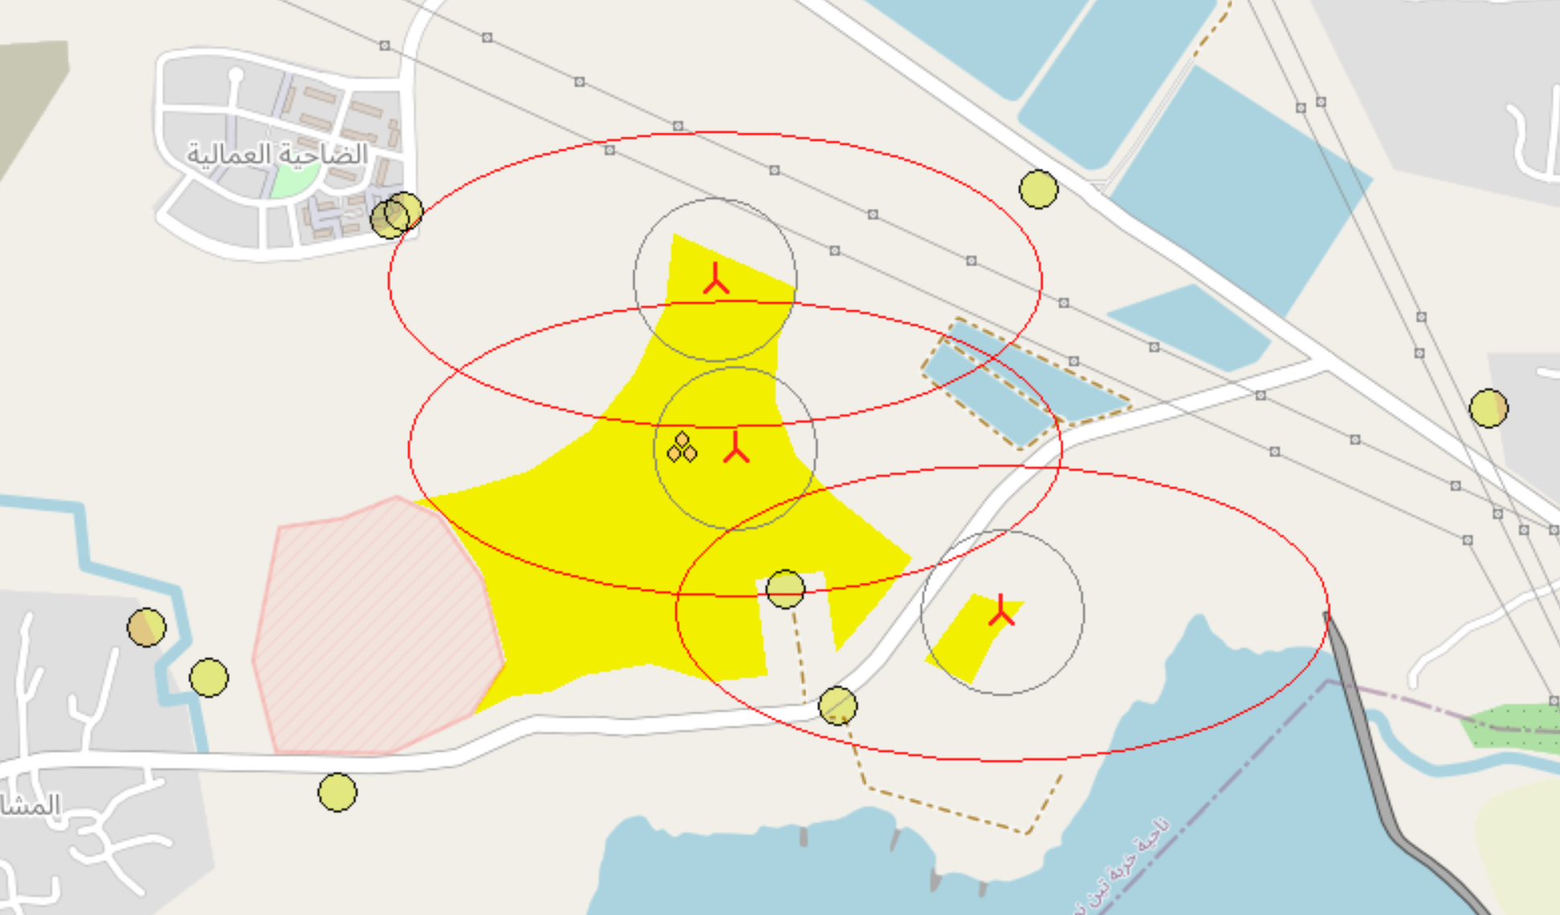
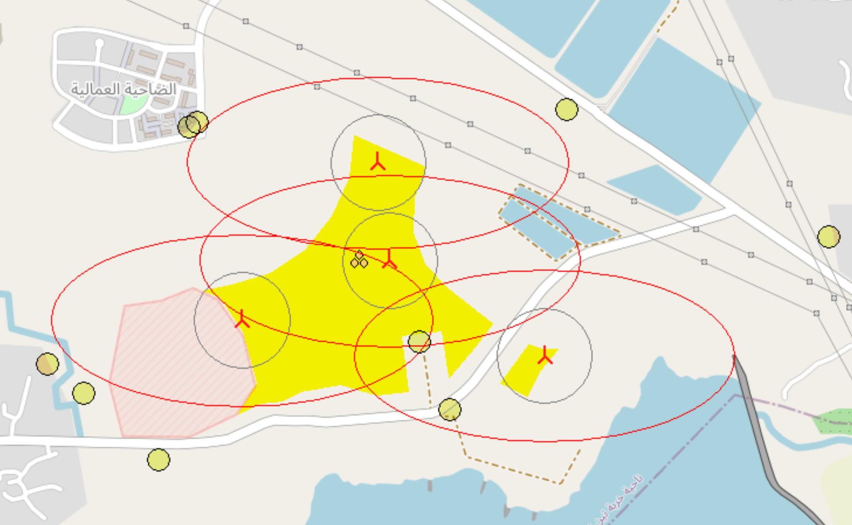
Progress: Windfarm optimization
First Layouts of the Windfarm:
3 x OSY160-5.0 MW
4 x OSY160-5.0 MW
Luis Urhahn

Slide 6
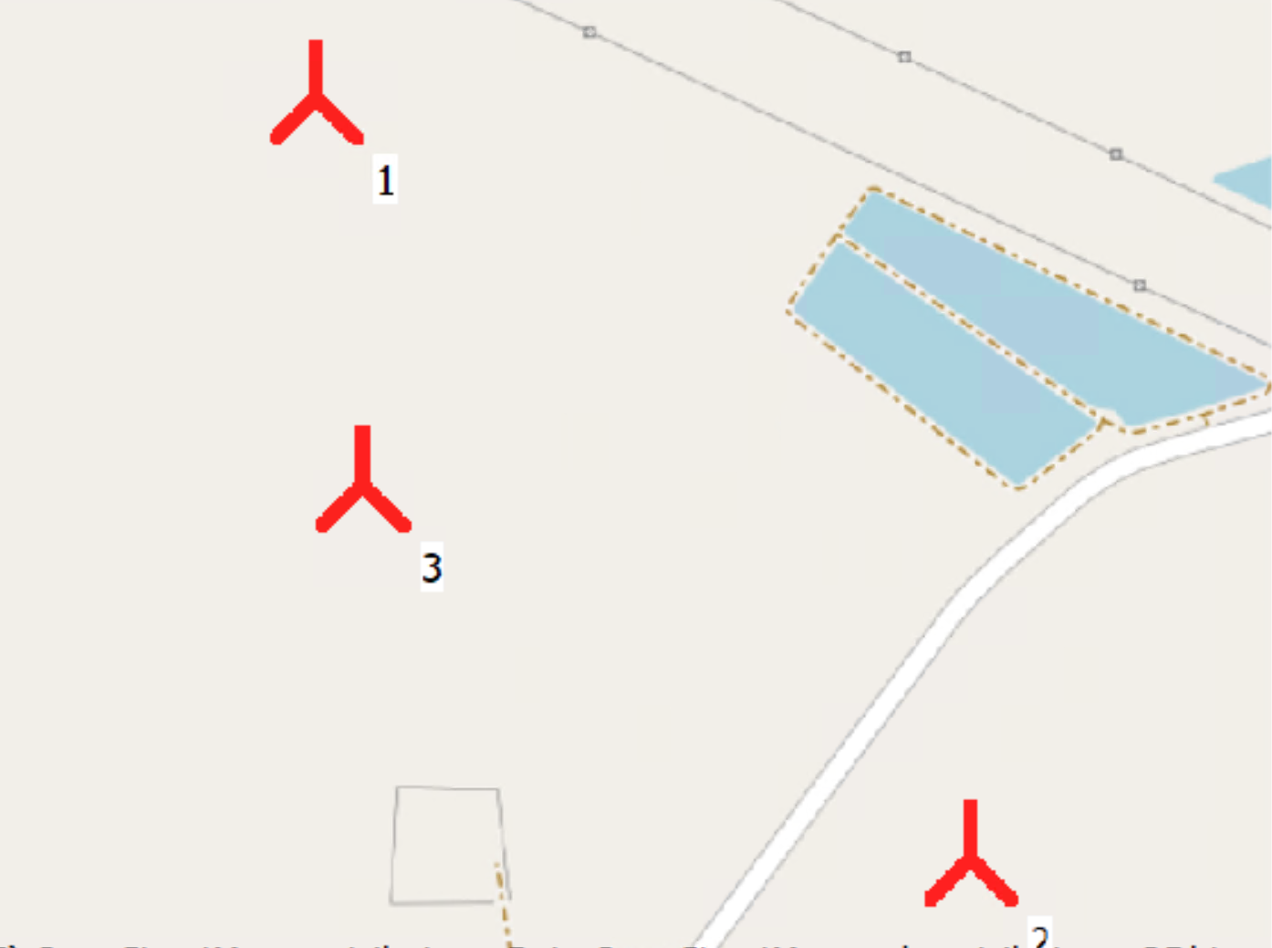
Progress: WindPro Simulation
Park Calculation 3xOSY160-5.0MW:
Parameter | Unit | Value
Result Park (AEP) (no loss) | MWh/year | 67 262.7
Result Park (AEP) | MWh/year | 66 108.7
Capacity factor | % | 50.3
Full Load Hours (FLH) | Hours/year | 4 407
Average wind speed | m/s | 8.5
Wake loss | % | 1.7
WTG No. | Wake loss
1 | 0.5 %
2 | 2.3 %
3 | 2.4 %
With < 5% in a perfect range.
Without any curtailments/restrictions!
Luis Urhahn

Slide 7
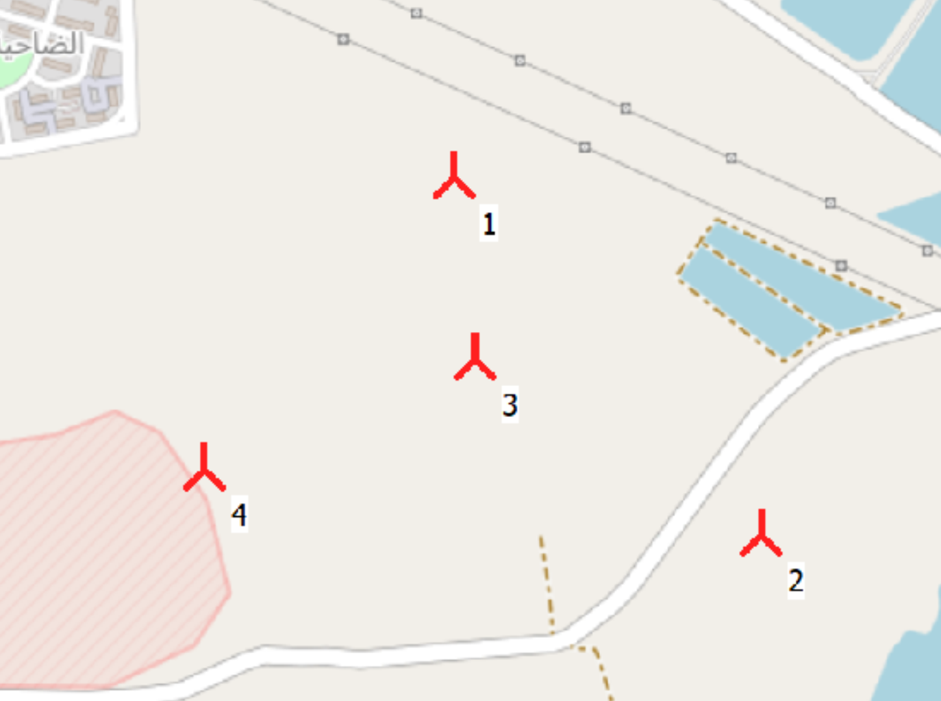
Progress: WindPro Simulation
Park Calculation 4xOSY160-5.0MW:
Parameter | Unit | Value
Result Park (AEP) (no loss) | MWh/year | 89 788.3
Result Park (AEP) | MWh/year | 87 468.1
Capacity factor | % | 49.9
Full Load Hours (FLH) | Hours/year | 4 373
Average wind speed | m/s | 8.5
Wake loss | % | 2.6
WTG No. | Wake loss
1 | 0.9 %
2 | 4.8 %
3 | 4.1 %
4 | 0.6 %
With < 5% in a good range.
Without any curtailments/restrictions!
Luis Urhahn

Slide 8
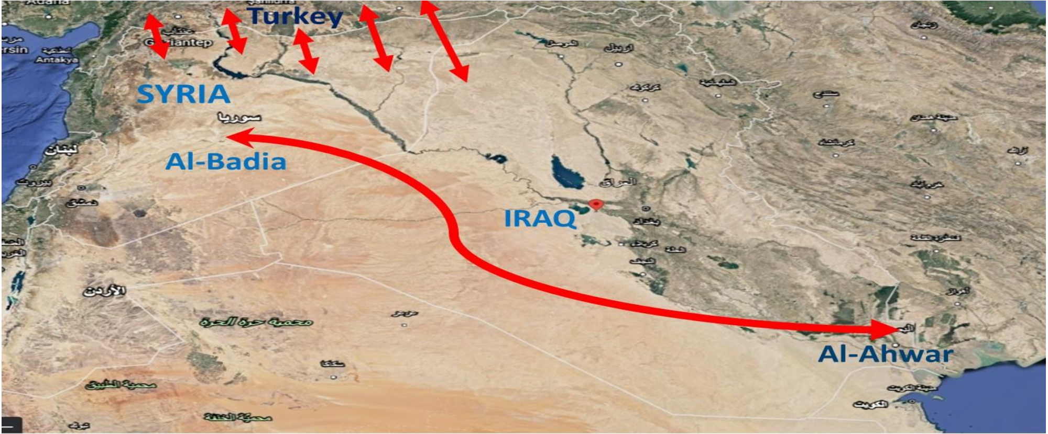
1.Global Bird Migration
Syria serves as a vital geographical gateway for bird migration due to its location at the intersection of three continents: Asia, Africa, and Europe
Seasonal Movement: Millions of birds cross this region twice a year, Generally, birds in the Northern Hemisphere take a north-south path during the fall and the opposite direction in the spring
https://creativecommons.org/licenses/by/4.0/
Sohil Mansuri

Slide 9
• Inland Desert (Al-Badia): Most migratory wild birds in Syria frequent the desert areas, specifically the Syrian Al-Badia, which is characterized by high biodiversity of wild plants that serve as primary food sources
• Border Regions: Significant areas for bird biodiversity exist along the borders between Syria, Iraq, and Turkey
• Water Bodies: Although the sources note that Syria has fewer water bodies than Iraq, migratory waterfowl such as storks, pelicans, ducks, and geese heavily utilize available Syrian water sources during their transit
In Syria, 85 species were considered as winter visitors, 15species as summer visitors in an unlike statistic, 143 species of migratory birds stopped breeding in Syria. 71 species of migratory birds that do not breed. 83 species that live throughout the winter season. 15 species of birds that live throughout the summer. Also, 53 of these species of birds are considered endangered (Salloum, 2020).
https://creativecommons.org/licenses/by/4.0/
Sohail Mansuri

Slide 10
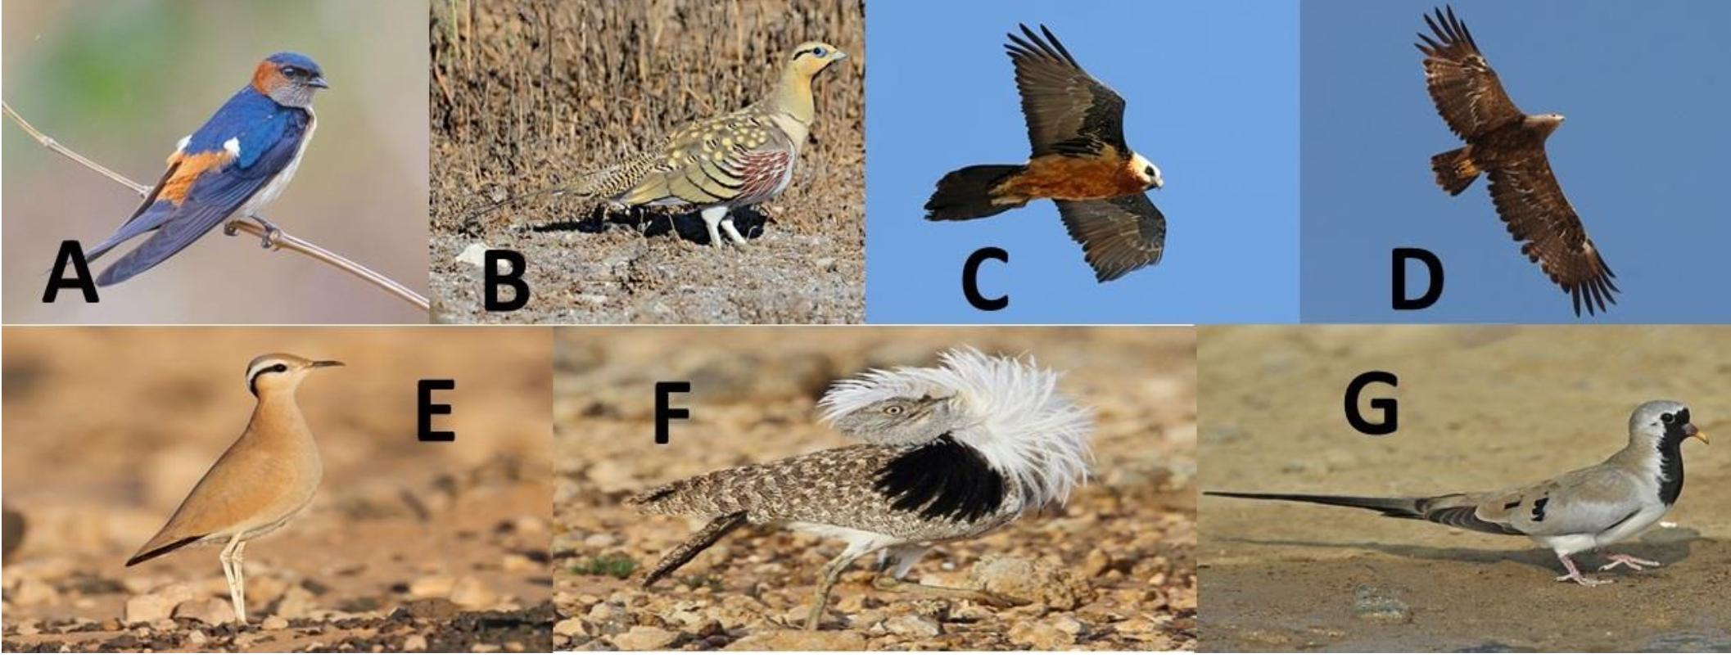
2.The Threatened and red list Migratory Birds
The most important species of migratory wild birds in Syria, which have been considered in the context of conservation concern and globally threatened with extinction.
A: Red-rumped Swallow (Hirundo daurica), B: Pin-tailed Sandgrouse (Pterocles alchata), C: Bearded Vulture (Gypaetus barbatus), D: Steppe Eagle (Aquila nipalensis), E: Cream-coloured Courser (Cursorius cursor), F: Houbara bustard(Otis tarda), G: Namaqua Dove (Oena Capensis)
Source:https://ebird.org
Sohil Mansuri

Slide 11
Bibliography – Project Development
[1] WindPro, University License for WindPro [Software] (latest on 19.12.25)
[2] Google Gemini, Student License for Gemini [AI] (latest on 08.12.25)
[3] University of Al-Qadisiyah , College of Agriculture DOI: 10.33794/qjas.2022.133702.1041 This is an open access article under the CC BY 4.0 licence (https://creativecommons.org/licenses/by/4.0/)
→ Simulation developed with the help of AI.
Luis Urhahn

